Slide 1
Mehran S. Fallah June 2020
Discrete Mathematics
Session XI
An Introduction to Logic

Slide 2
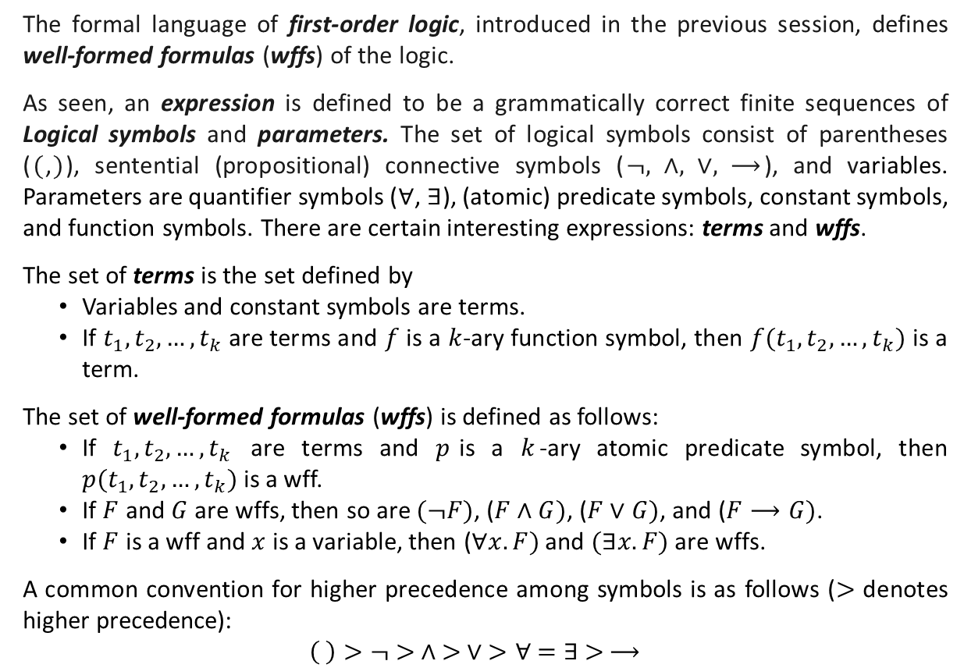
Introduction
The formal language of first-order logic, introduced in the previous session, defines well-formed formulas (wffs) of the logic.
As seen, an expression is defined to be a grammatically correct finite sequences of Logical symbols and parameters. The set of logical symbols consist of parentheses ($($,$)$), sentential (propositional) connective symbols ($¬, ∧, ∨, ⟶$), and variables. Parameters are quantifier symbols ($∀$, $∃$), (atomic) predicate symbols, constant symbols, and function symbols. There are certain interesting expressions: terms and wffs.
The set of terms is the set defined by
Variables and constant symbols are terms.
If $t_{1}, t_{2}, …, t_{k}$ are terms and $f$ is a $k$-ary function symbol, then $f(t_{1}, t_{2}, …, t_{k})$ is a term.
The set of well-formed formulas (wffs) is defined as follows:
If $t_{1}, t_{2}, …, t_{k}$ are terms and $p$is a $k$-ary atomic predicate symbol, then $p(t_{1}, t_{2}, …, t_{k})$ is a wff.
If $F$ and $G$ are wffs, then so are $(¬F)$, ($F∧G)$, ($F∨G)$, and ($F⟶G)$.
If $F$ is a wff and $x$ is a variable, then ($∀x. F)$ and $(∃x.F)$ are wffs.
A common convention for higher precedence among symbols is as follows ($>$ denotes higher precedence):
$$\left( \right)>¬ > ∧ > ∨ >∀ =∃ > ⟶$$

Slide 3
Introduction (Ctd.)
It was also explained that translation from a natural language to the formal language of first-order logic bears some notion of meaning.
However, to give meaning to well-formed formulas of first-order logic, we need a formal semantics for the formal language.
As with propositional logic, we should define models so that one can interpret a given formula.
In propositional logic, models are truth assignments, which tell us which atomic proposition symbols are to be interpreted as being true and which as false.
In first-order logic the analogous role is played by structures (or interpretations), which can be thought of as providing the dictionary for translations from the formal language into a natural language (English, Persian, …).
A structure indeed gives meaning to the parameters so that some formulas of the formal language can be interpreted as true and some as false.
By giving meaning to the formulas of the logic, one can revisit the concepts of logical equivalence and logical implication in first-order logic.

Slide 4
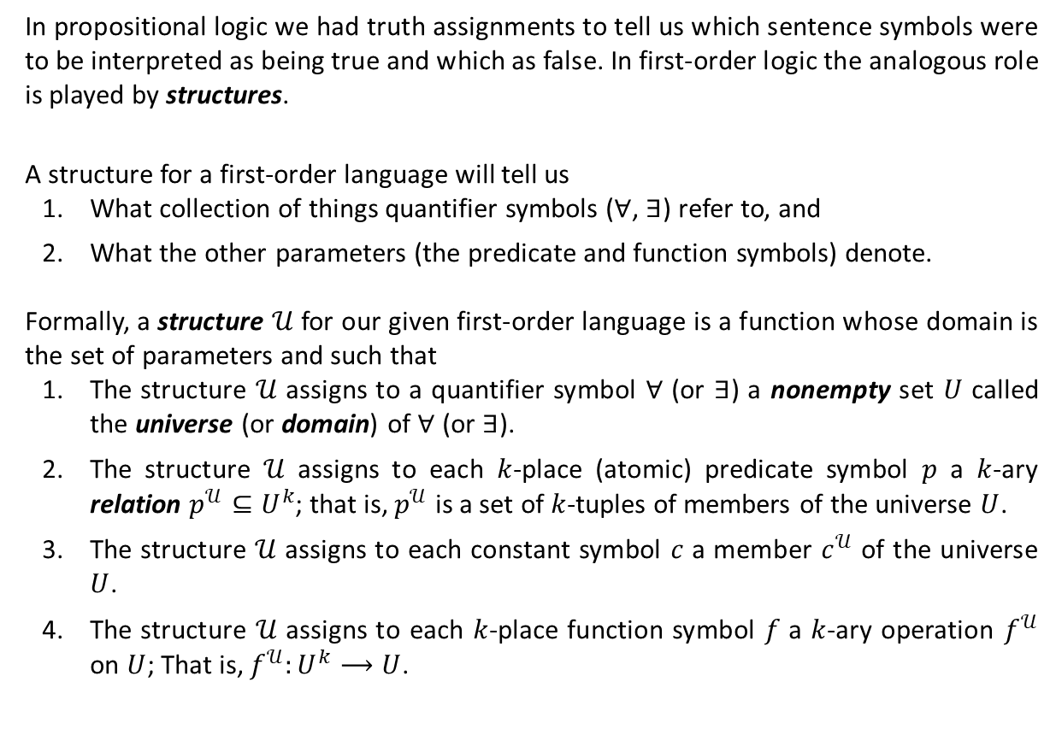
Truth and Models
In propositional logic we had truth assignments to tell us which sentence symbols were to be interpreted as being true and which as false. In first-order logic the analogous role is played by structures.
A structure for a first-order language will tell us
What collection of things quantifier symbols ($∀$, $∃$) refer to, and
What the other parameters (the predicate and function symbols) denote.
Formally, a structure $𝒰$ for our given first-order language is a function whose domain is the set of parameters and such that
The structure $𝒰$ assigns to a quantifier symbol $∀$ (or $∃$) a nonempty set $U$ called the universe (or domain) of $∀$ (or $∃$).
The structure $𝒰$ assigns to each $k$-place (atomic) predicate symbol $p$ a $k$-ary relation $p^{𝒰}⊆U^{k}$; that is, $p^{𝒰}$ is a set of $k$-tuples of members of the universe $U$.
The structure $𝒰$ assigns to each constant symbol $c$ a member $c^{𝒰}$ of the universe $U$.
The structure $𝒰$ assigns to each $k$-place function symbol $f$ a $k$-ary operation $f^{𝒰}$ on $U$; That is, $f^{𝒰}:U^{k}⟶U$.

Slide 5
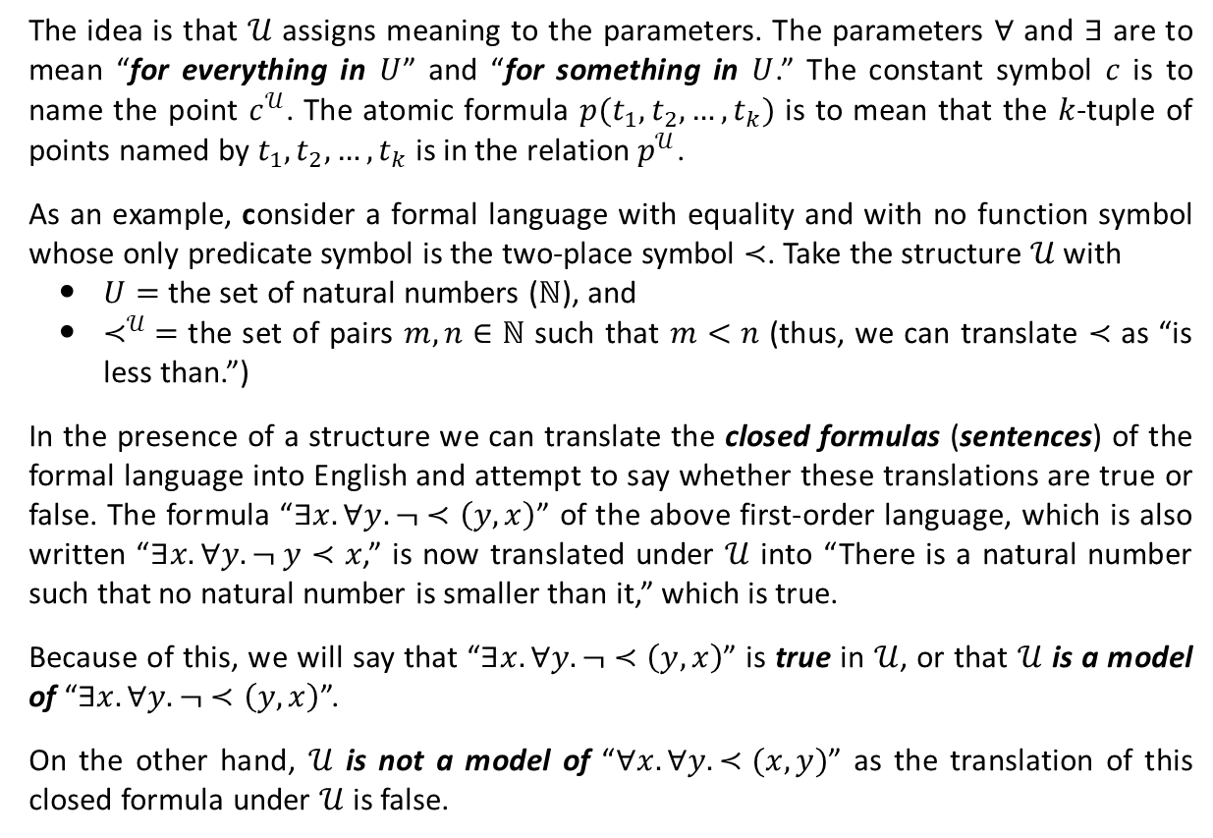
Truth and Models (Ctd.)
The idea is that $𝒰$ assigns meaning to the parameters. The parameters $∀$ and $∃$ are to mean “for everything in $U$” and “for something in $U$.” The constant symbol $c$ is to name the point $c^{𝒰}$. The atomic formula $p(t_{1},t_{2},…,t_{k})$ is to mean that the $k$-tuple of points named by $t_{1},t_{2},…,t_{k}$ is in the relation $p^{𝒰}$.
As an example, consider a formal language with equality and with no function symbol whose only predicate symbol is the two-place symbol $≺$. Take the structure $𝒰$ with
$U=$ the set of natural numbers ($ℕ$), and
$≺^{𝒰} =$ the set of pairs $m,n∈ℕ$ such that $m<n$ (thus, we can translate $≺$ as “is less than.”)
In the presence of a structure we can translate the closed formulas (sentences) of the formal language into English and attempt to say whether these translations are true or false. The formula “$∃x.∀y.¬ ≺\left(y, x\right)$” of the above first-order language, which is also written “$∃x.∀y.¬ y≺x$,” is now translated under $𝒰$ into “There is a natural number such that no natural number is smaller than it,” which is true.
Because of this, we will say that “$∃x.∀y.¬ ≺\left(y, x\right)$” is true in $𝒰$, or that $𝒰$ is a model of “$∃x.∀y.¬ ≺\left(y, x\right)$”.
On the other hand, $𝒰$ is not a model of “$∀x. ∀y. ≺(x,y)$” as the translation of this closed formula under $𝒰$ is false.

Slide 6
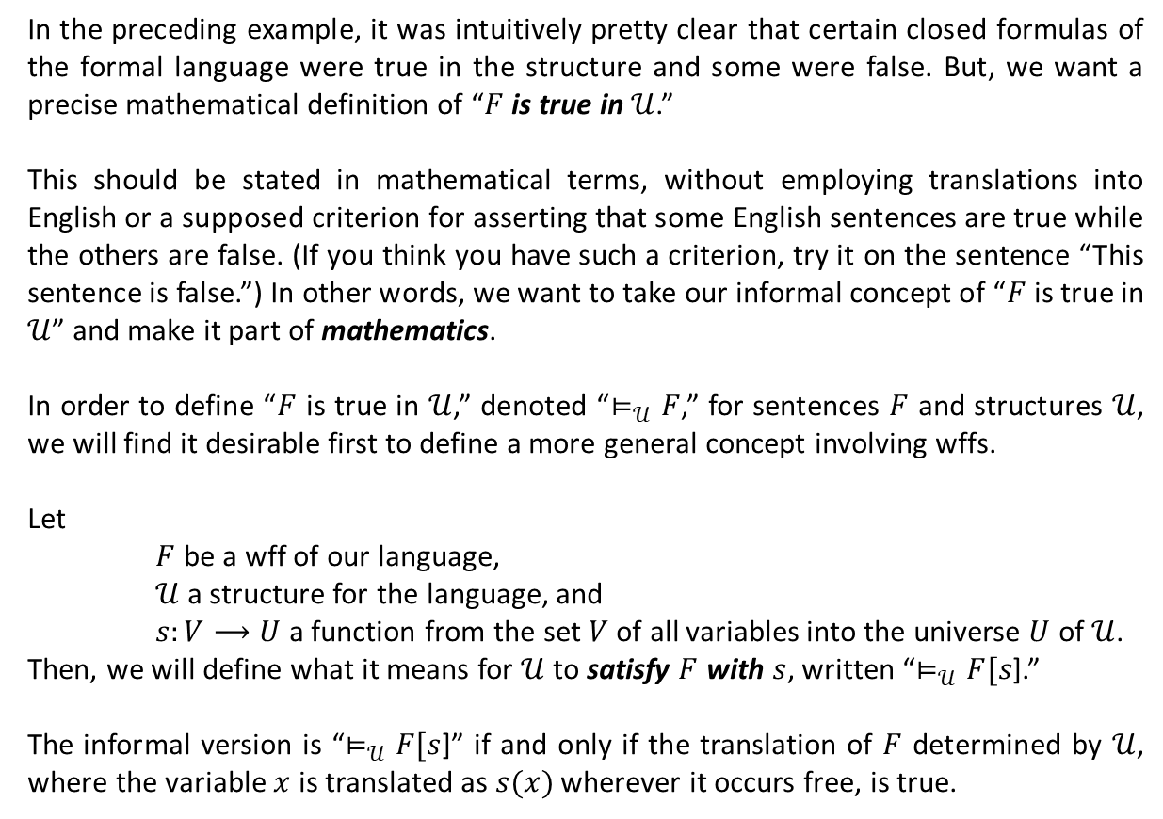
Truth and Models (Ctd.)
In the preceding example, it was intuitively pretty clear that certain closed formulas of the formal language were true in the structure and some were false. But, we want a precise mathematical definition of “$F$ is true in $𝒰$.”
This should be stated in mathematical terms, without employing translations into English or a supposed criterion for asserting that some English sentences are true while the others are false. (If you think you have such a criterion, try it on the sentence “This sentence is false.”) In other words, we want to take our informal concept of “$F$ is true in $𝒰$” and make it part of mathematics.
In order to define “$F$ is true in $𝒰$,” denoted “$⊨_{𝒰}F$,” for sentences $F$ and structures $𝒰$, we will find it desirable first to define a more general concept involving wffs.
Let
$F$ be a wff of our language,
$𝒰$ a structure for the language, and
$s:V⟶U$ a function from the set $V$ of all variables into the universe $U$ of $𝒰$.
Then, we will define what it means for $𝒰$ to satisfy $F$ with $s$, written “$⊨_{𝒰}F[s$].”
The informal version is “$⊨_{𝒰}F[s$]” if and only if the translation of $F$ determined by $𝒰$, where the variable $x$ is translated as $s(x)$ wherever it occurs free, is true.

Slide 7

Truth and Models (Ctd.)
For terms, we define the extension $\overline{s}:T⟶U$, a function from the set $T$ of all terms into the universe of $𝒰$, as follows:
For each variable $x$, $\overline{s}\left(x\right)=s(x)$.
For each constant symbol $c$, $\overline{s}\left(c\right)=c^{𝒰}$.
If $t_{1},t_{2},…,t_{k}$ are terms and $f$ is a $k$-place function symbol, then $\overline{s}\left(f\left(t_{1},t_{2},…,t_{k}\right)\right)=f^{𝒰}\left(\overline{s}\left(t_{1}\right),\overline{s}\left(t_{2}\right)\text{,…,}\overline{s}\left(t_{k}\right)\right)$.
Definition 1. We say that the structure $𝒰$ satisfies the wff $F$ with the function $s:V⟶U$, written $⊨_{𝒰}F[s]$, and define it recursively as follows:
Here $s\left(x | d\right)$ is the function which is exactly like $s$except for one thing: At the variable x it assumes the value d.
$⊨_{𝒰}p\left(t_{1},t_{2},…,t_{k}\right)[s]$ iff $\left(\overline{s}\left(t_{1}\right),\overline{s}\left(t_{2}\right)\text{,…,}\overline{s}\left(t_{k}\right)\right)∈p^{𝒰}$.
$⊨_{𝒰}¬F[s]$ iff $⊭_{𝒰}F\left[s\right]$.
$⊨_{𝒰}(F∧G)[s]$ iff $⊨_{𝒰}F\left[s\right]$ and $⊨_{𝒰}G\left[s\right]$.
$⊨_{𝒰}(F∨G)[s]$ iff either $⊨_{𝒰}F\left[s\right]$ or $⊨_{𝒰}G\left[s\right]$ (or both.)
$⊨_{𝒰}(F⟶G)[s]$ iff either $⊭_{𝒰}F\left[s\right]$ or $⊨_{𝒰}G\left[s\right]$ (or both.)
$⊨_{𝒰}(∀x.F)[s]$ iff for every $d∈U$, $⊨_{𝒰}F[s\left(x | d\right)]$.
$⊨_{𝒰}(∃x.F)[s]$ iff for some $d∈U$, $⊨_{𝒰}F[s\left(x | d\right)]$.

Slide 8
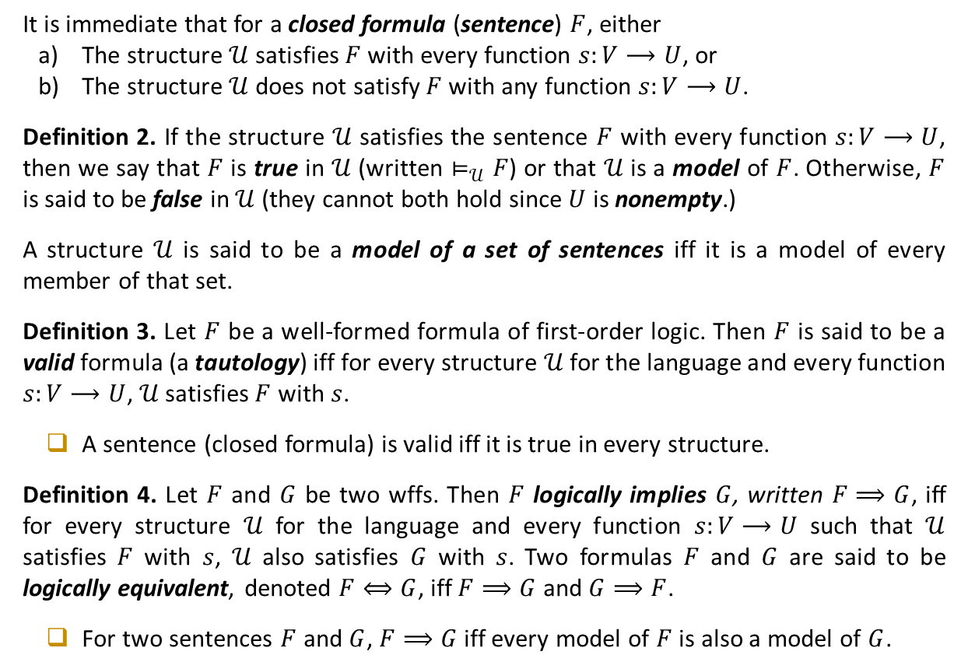
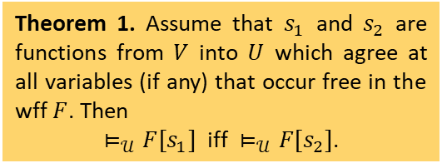
Truth and Models (Ctd.)
Theorem 1. Assume that $s_{1}$ and $s_{2}$ are functions from $V$ into $U$ which agree at all variables (if any) that occur free in the wff $F$. Then
$⊨_{𝒰}F[s_{1}]$ iff $⊨_{𝒰}F[s_{2}]$.
It is immediate that for a closed formula (sentence) $F$, either
The structure $𝒰$ satisfies $F$ with every function $s:V⟶U$, or
The structure $𝒰$ does not satisfy $F$ with any function $s:V⟶U$.
Definition 2. If the structure $𝒰$ satisfies the sentence $F$ with every function $s:V⟶U$, then we say that $F$ is true in $𝒰$ (written $⊨_{𝒰}F$) or that $𝒰$ is a model of $F$. Otherwise, $F$ is said to be false in $𝒰$ (they cannot both hold since $U$ is nonempty.)
A structure $𝒰$ is said to be a model of a set of sentences iff it is a model of every member of that set.
Definition 3. Let $F$ be a well-formed formula of first-order logic. Then $F$ is said to be a valid formula (a tautology) iff for every structure $𝒰$ for the language and every function $s:V⟶U$, $𝒰$ satisfies $F$ with $s$.
A sentence (closed formula) is valid iff it is true in every structure.
Definition 4. Let $F$ and $G$ be two wffs. Then $F$ logically implies $G$, written $F⟹G$, iff for every structure $𝒰$ for the language and every function $s:V⟶U$ such that $𝒰$ satisfies $F$ with $s$, $𝒰$ also satisfies $G$ with $s$. Two formulas $F$ and $G$ are said to be logically equivalent, denoted $F⟺G$, iff $F⟹G$ and $G⟹F$.
For two sentences $F$ and $G$, $F⟹G$ iff every model of $F$ is also a model of $G$.

Slide 9
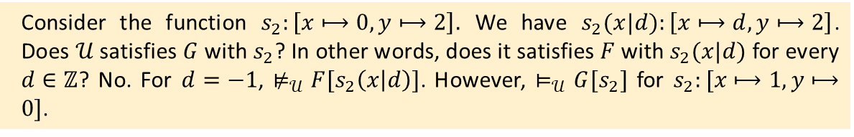
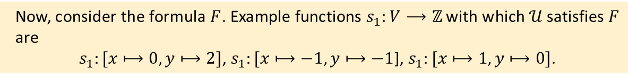


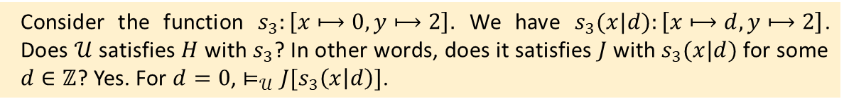
Truth and Models (Ctd.)
$⊨_{𝒰}(∀x.F)[s]$ iff for every $d∈U$, $⊨_{𝒰}F[s\left(x | d\right)]$.
$⊨_{𝒰}(∃x.F)[s]$ iff for some $d∈U$, $⊨_{𝒰}F[s\left(x | d\right)]$.
Example 1. The structure $𝒰$ is given as follows: the predicate symbols $≤$, $=$, and $≠$ are respectively interpreted as the binary relations “is less than or equal to,” “is equal to,” and “is not equal to” on the set $ℤ$ of integers. Moreover, the constant symbols $0$ and $1$ are interpreted as the integers $0$ and 1. The binary function symbols $+$ and $−$ are also mapped to the functions “addition” and “subtraction” defined on pairs of integers. Finally, the unary function symbol $⋅^{2}$ is interpreted as the “square” operation on integers. Let $F$, $G$, and $H$ be the following wffs of first-order logic.
$F: x+1=0⟶x^{2}+y≤1$
$G: ∀x. (x+1=0⟶x^{2}+y≤1)$
$H: ∃x. \left(∀y. y≤y+x\right)∧(0−x^{2}=x)$.
Give functions $s_{1},s_{2},s_{3}:V⟶U$ such that $⊨_{𝒰}F[s_{1}]$, $⊨_{𝒰}G[s_{2}]$, and $⊨_{𝒰}H[s_{3}]$ hold.
Solution. First note that $U=ℤ$. The structure $𝒰$ assigns “less than or equal to” relation on $ℤ$ (that is, $≤^{𝒰}$) to the symbol $≤$ and the binary “addition operation” on $ℤ$ (that is, $+^{𝒰}$) to the symbol $+$. Similarly, the structure assigns integers as well as relations and operations to the symbols $0$, $1$, $=$, $≠$, $−$, and $⋅^{2}$.
$$J$$
Is $H$ true in $𝒰$? That is, does $𝒰$ satisfy $H$ for every function $s_{3}:V⟶ℤ$?
Yes. For $d=0$, $⊨_{𝒰}J[s_{3}\left(x | d\right)]$ holds for every function $s_{3}:V⟶ℤ$.
Consider the function $s_{2}:\left[x⟼0, y⟼2\right].$ We have $s_{2}(x|d):\left[x⟼d, y⟼2\right]$. Does $𝒰$ satisfies $G$ with $s_{2}$? In other words, does it satisfies $F$ with $s_{2}(x|d)$ for every $d∈ℤ$? No. For $d=−1$, $⊭_{𝒰}F[s_{2}\left(x | d\right)]$. However, $⊨_{𝒰}G[s_{2}]$ for $s_{2}:[x⟼1, y⟼0]$.
Consider the function $s_{3}:\left[x⟼0, y⟼2\right].$ We have $s_{3}(x|d):\left[x⟼d, y⟼2\right]$. Does $𝒰$ satisfies $H$ with $s_{3}$? In other words, does it satisfies $J$ with $s_{3}(x|d)$ for some $d∈ℤ$? Yes. For $d=0$, $⊨_{𝒰}J[s_{3}\left(x | d\right)]$.
Now, consider the formula $F$. Example functions $s_{1}:V⟶ℤ$ with which $𝒰$ satisfies $F$ are
$s_{1}:[x⟼0, y⟼2]$, $s_{1}:[x⟼−1, y⟼−1$], $s_{1}:[x⟼1, y⟼0]$.

Slide 10








Truth and Models (Ctd.)
Example 2. Let $𝒰$ be the structure defined in Example 1. Establish the truth or falsity of the following sentences (closed formulas) in $𝒰$.
Example 3. Is $∀x. ∃y.(x≤y∧x≠y)$ a valid formula?
Solution. No. We can find structures $𝒰$ such that the formula is not true in $𝒰$. An example is the structure $𝒰$ whose universe is the subset $U=\{−1, 0, 1, 2, 3, 4, 5\}$ of $ℤ$ and the symbols are assigned to the integers, relations, and operations as in the previous example.
a) $∀x. \left(x+1=0⟶x^{2}≤1\right)$
True
b) $∀x. \left(x+1≤0⟶1≤x^{2}\right)$
True
c) $∃x. \left(x+1≤0⟶∃y. y≤x−y^{2}\right)$
True
d) $∀x. ∃y.(x≤y∧x≠y)$
True
e) $∃y. ∀x. (x≤y∧x≠y)$
False
f) $∀x. (∀y. y≤x⟶x^{2}+1≤0)$
True
g) $¬∃x. ∀y. y≤x⟶{∃x. x}^{2}+1≤0$
False
h) $∃x. \left(∀y. y+x=y∧\left(∀z. \left(\left(∀y. z+y=y \right) ⟶x=z\right)\right)\right)$
True

Slide 11


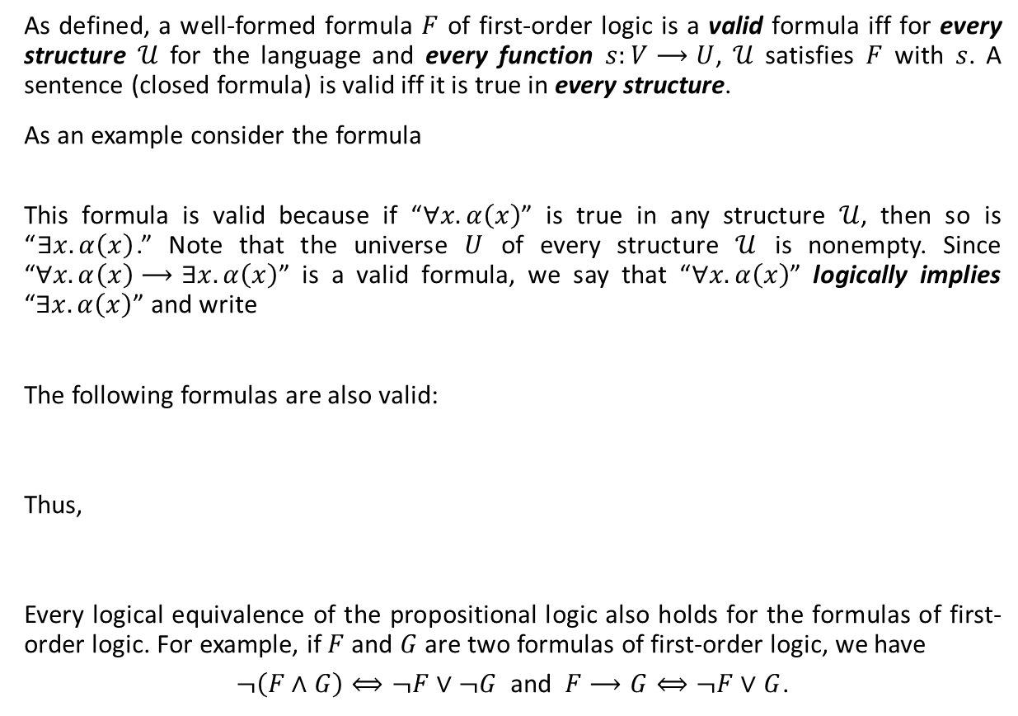



Valid Formulas
As defined, a well-formed formula $F$ of first-order logic is a valid formula iff for every structure $𝒰$ for the language and every function $s:V⟶U$, $𝒰$ satisfies $F$ with $s$. A sentence (closed formula) is valid iff it is true in every structure.
As an example consider the formula
This formula is valid because if “$∀x. α\left(x\right)$” is true in any structure $𝒰$, then so is “$∃x. α\left(x\right)$.” Note that the universe $U$ of every structure $𝒰$ is nonempty. Since “$∀x. α\left(x\right)⟶∃x. α\left(x\right)$” is a valid formula, we say that “$∀x. α\left(x\right)$” logically implies “$∃x. α\left(x\right)$” and write
The following formulas are also valid:
Thus,
Every logical equivalence of the propositional logic also holds for the formulas of first-order logic. For example, if $F$ and $G$ are two formulas of first-order logic, we have
$¬\left(F∧G\right)⟺¬F∨¬G$ and $F⟶G⟺¬F∨G$.
$$∀x. α\left(x\right)⟶∃x. α\left(x\right).$$
$$∀x. α\left(x\right)⟹∃x. α\left(x\right).$$
$∃x. α\left(x\right)⟶¬∀x. ¬α\left(x\right)$.
$¬∀x. ¬α\left(x\right)⟶∃x. α\left(x\right)$.
$∃x. α\left(x\right)⟺¬∀x. ¬α\left(x\right)$.

Slide 12





Valid Formulas (Ctd.)
Example 4. Negate the following formula and simplify the result.
Solution. We have
The following also hold in first-order logic.
$$∀x. ∃y. \left(α\left(x,y\right)∧β\left(x,y\right)⟶∀x. γ\left(x\right)\right).$$
$$¬\left(∀x. ∃y. \left(α\left(x,y\right)∧β\left(x,y\right)⟶∀x. γ\left(x\right)\right)\right)$$
$⟺∃x. ¬∃y.$ $\left(α\left(x,y\right)∧β\left(x,y\right)⟶∀x. γ\left(x\right)\right)$
$$⟺∃x. ∀y. ¬\left(α\left(x,y\right)∧β\left(x,y\right)⟶∀x. γ\left(x\right)\right)$$
$$⟺∃x. ∀y. ¬\left(¬\left(α\left(x,y\right)∧β\left(x,y\right)\right)∨∀x. γ\left(x\right)\right)$$
$$⟺∃x. ∀y.\left(\left(α\left(x,y\right)∧β\left(x,y\right)\right)∧¬∀x. γ\left(x\right)\right)$$
$$⟺∃x. ∀y.\left(\left(α\left(x,y\right)∧β\left(x,y\right)\right)∧∃x. ¬γ\left(x\right)\right).$$
$$∀x. \left(α\left(x\right)∧β\left(x\right)\right)⟺\left(∀x. α\left(x\right)\right)∧\left(∀x. β\left(x\right)\right)$$
$$\left(∀x. α\left(x\right)\right)∨\left(∀x. β\left(x\right)\right)⟹∀x. \left(α\left(x\right)∨β\left(x\right)\right)$$
$$∃x. \left(α\left(x\right)∨β\left(x\right)\right)⟺\left(∃x. α\left(x\right)\right)∨\left(∃x. β\left(x\right)\right)$$
$$∃x. \left(α\left(x\right)∧β\left(x\right)\right)⟹\left(∃x. α\left(x\right)\right)∧\left(∃x. β\left(x\right)\right)$$
$$∀x. ∀y. α\left(x,y\right)⟺∀y.∀x.α\left(x,y\right)$$
$$∃x. ∃y. α\left(x,y\right)⟺∃y.∃x.α\left(x,y\right)$$
$$∃x. ∀y. α\left(x,y\right)⟹∀y.∃x.α\left(x,y\right)$$

Slide 13
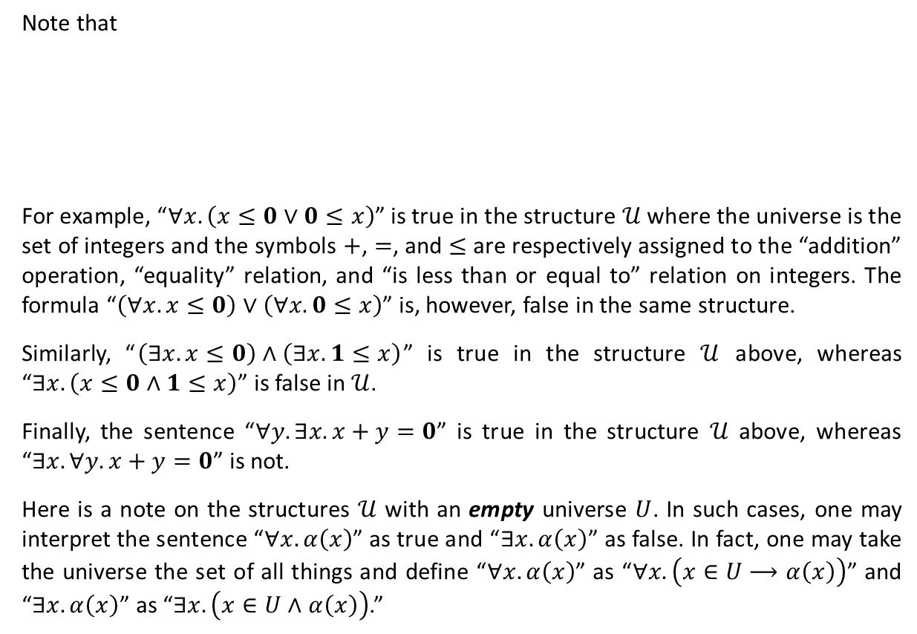
Valid Formulas (Ctd.)
Note that
For example, “$∀x. \left(x≤0∨0≤x\right)$” is true in the structure $𝒰$ where the universe is the set of integers and the symbols $+$, $=$, and $≤$ are respectively assigned to the “addition” operation, “equality” relation, and “is less than or equal to” relation on integers. The formula “$\left(∀x.x≤0\right)∨\left(∀x.0≤x\right)$” is, however, false in the same structure.
Similarly, “$\left(∃x. x≤0\right)∧\left(∃x. 1≤x\right)$” is true in the structure $𝒰$ above, whereas “$∃x. \left(x≤0∧1≤x\right)$” is false in $𝒰$.
Finally, the sentence “$∀y.∃x.x+y=0$” is true in the structure $𝒰$ above, whereas “$∃x.∀y. x+y=0$” is not.
Here is a note on the structures $𝒰$ with an empty universe $U$. In such cases, one may interpret the sentence “$∀x. α\left(x\right)$” as true and “$∃x. α\left(x\right)$” as false. In fact, one may take the universe the set of all things and define “$∀x. α\left(x\right)$” as “$∀x. \left(x∈U⟶α\left(x\right)\right)$” and “$∃x. α\left(x\right)$” as “$∃x. \left(x∈U∧α\left(x\right)\right)$.”
$$∀x. \left(α\left(x\right)∨β\left(x\right)\right)⇏\left(∀x. α\left(x\right)\right)∨\left(∀x. β\left(x\right)\right)$$
$$\left(∃x. α\left(x\right)\right)∧\left(∃x. β\left(x\right)\right) ⇏ ∃x. \left(α\left(x\right)∧β\left(x\right)\right)$$
$$∀y.∃x.α\left(x,y\right)⇏∃x. ∀y. α\left(x,y\right)$$

Slide 14
Textbook: Ralph P. Grimaldi, Discrete and Combinatorial Mathematics
Do exercises of Chapter 2 as homework and upload your solutions via Moodle (follow the instructions on the page of the TA of this course.)

